Slide 1
WALL STREET QUANTS | BOOTCAMP PROJECT
Statistical Arbitrage in
Cryptocurrency Markets
Momentum and reversal research on live market data
1.02
20.6%
-0.02
Net Sharpe (combined)
Alpha per year
Beta to Bitcoin
Coinbase daily + hourly prices and Deribit DVOL | 2021-01-01 to 2026-10-08 | net of 20 / 7 bps costs

Slide 2
EXECUTIVE SUMMARY
Momentum + reversal: market-neutral, profitable after costs
- Horizon decides the sign. Crypto shows momentum from 1 to 30 days (peak at 14 days, Sharpe 1.09). Reversal appears only intraday and at 60-90 days.
- Intraday reversal is huge but untradeable. 1-hour reversal has a gross Sharpe of 4.91, but costs wipe it out.
- The brief's conditioning variables work. Volume shocks, weekends, themes and calm option markets strengthen momentum; stress strengthens reversal.
- Final strategy: momentum ensemble + long-horizon reversal, mean-variance (shrunk) weights, market-neutral.
- Honest hold-out: Sharpe 0.55 in 2024-2026 vs 1.71 in research. Reversal held up; momentum decayed.
NET SHARPE
ALPHA / YEAR
1.02
20.6%
vs 0.45 for BTC
t-stat 2.19
BETA TO BTC
MAX DRAWDOWN
-0.02
-28.1%
market-neutral
vs -67.0% for BTC
Full backtest 2021-12-28 to 2026-10-08; momentum at 20 bps market orders, reversal at 7 bps limit orders.
2

Slide 3
RESEARCH OUTLINE
Every item in the brief, tested
HOW TO FIND MOMENTUM
HOW TO FIND REVERSAL
Time horizon
Time horizon
Momentum at 1-30 days (CS peak 1.09)
1-hour reversal gross Sharpe 4.91; 60-day reversal tradable
New info / activity
Uninformed trading
Volume shock lifts 3-day momentum 0.79 -> 0.95
Low-activity moves: weaker 1-day momentum (0.18 vs 0.49)
Seasonality
Correlation
TS momentum: weekend Sharpe 1.77 vs weekday 0.39
Theme-residual reversal 0.78; pairs fail after cost
Themes
Macro
Theme momentum gross Sharpe 2.02 (research); decayed after
1-day reversal: -1.82 in calm vs 0.58 in volatile
Technical plays
confirmed
partly / gross only
not found
Front-running US session: 1.63 bps/day, not tradable
3

Slide 4
DATA AND METHOD
Live data, unconstrained backtests, honest hold-out
- Prices: Coinbase daily OHLCV (2021 onward) and hourly OHLCV (2022 onward). Binance is geo-blocked here (HTTP 451).
- Implied vol: Deribit DVOL, the crypto VIX.
- Universe: 16 liquid coins in 4 themes; XRP (listing gap) and MKR (delisted Jan-2026) excluded.
- Backtest: unconstrained, gross exposure = 1, positions lagged one day, no look-ahead.
- Costs: 20 bps per unit turnover for market orders, 7 bps for limit orders, sweep 0-200 bps.
- Discipline: all choices made on 2021-2023 data; 2024-2026 is an untouched hold-out.
2026-10-08
16
DATA THROUGH
COINS
44
668k
CANDIDATES TESTED
HOURLY BARS
THEMES
Payments & Meme: BTC LTC BCH XLM DOGE
Large L1: ETH SOL AVAX | Alt L1: ADA DOT ATOM ALGO
DeFi & Oracle: UNI AAVE COMP LINK
4

Slide 5
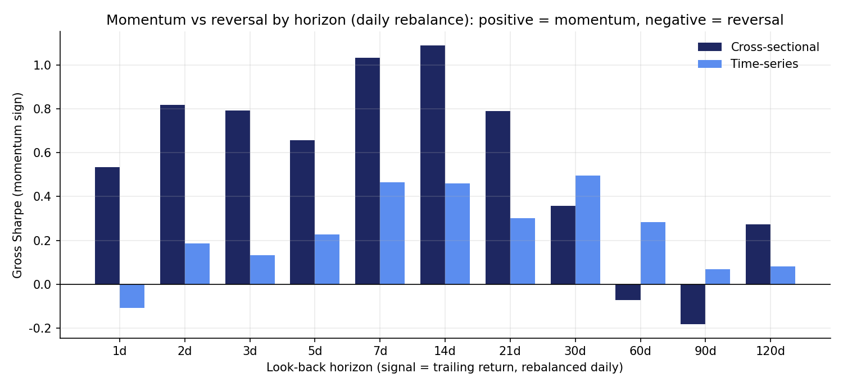
MOMENTUM VS REVERSAL: TIME HORIZON
Daily horizons show momentum; reversal lives at the extremes
PEAK MOMENTUM
1.09
cross-sectional, 14-day look-back
1-HOUR REVERSAL
4.91
gross Sharpe, hourly data
COST OF 1-DAY SIGNAL
~95%/yr
1.3x turnover/day at 20 bps
Opposite of the equity pattern in the brief, consistent with crypto evidence (Dobrynskaya).
5

Slide 6
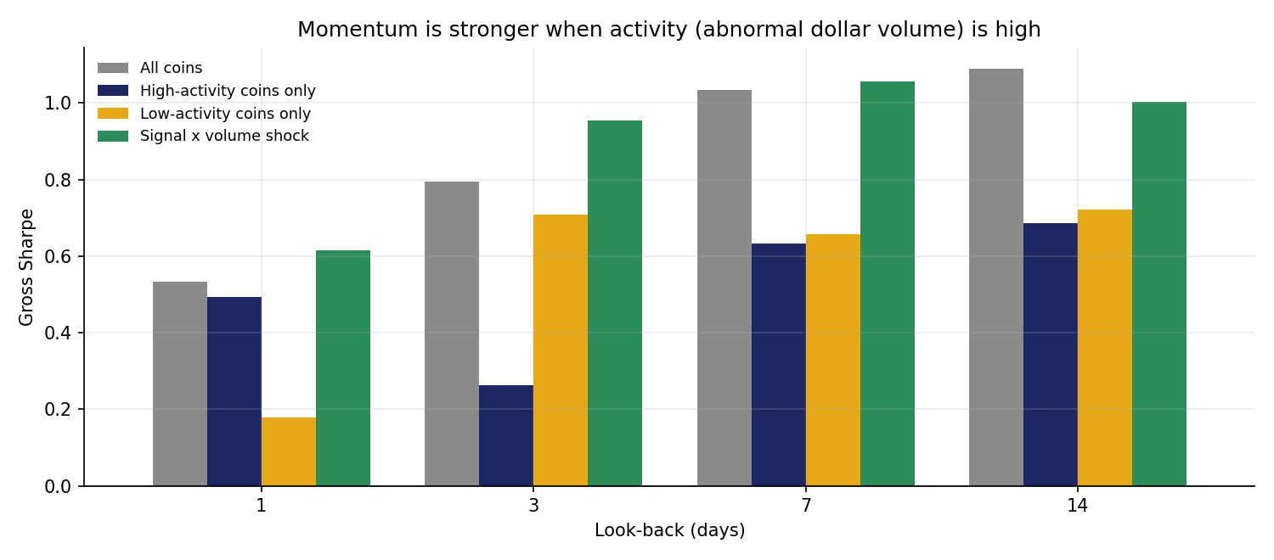
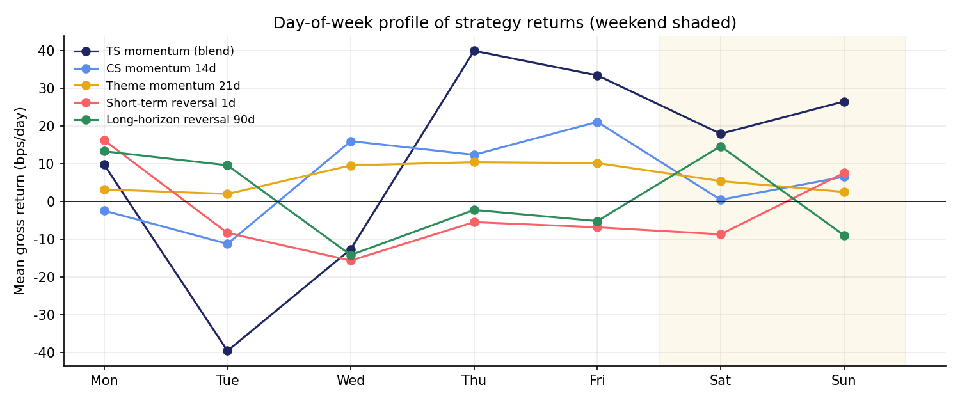
MOMENTUM: ACTIVITY AND SEASONALITY
Volume shocks and weekends strengthen momentum
- Weighting by volume shock lifts 1-day momentum 0.53 -> 0.61 and 3-day 0.79 -> 0.95.
- Holds in the hold-out (3-day: 0.63 -> 1.01).
- TS momentum Sharpe 1.77 on weekends vs 0.39 on weekdays: retail trends persist when institutions are away.
- Hourly: the US session averages -1.11 bps/hour on weekdays; gains accrue outside US hours.
6

Slide 7
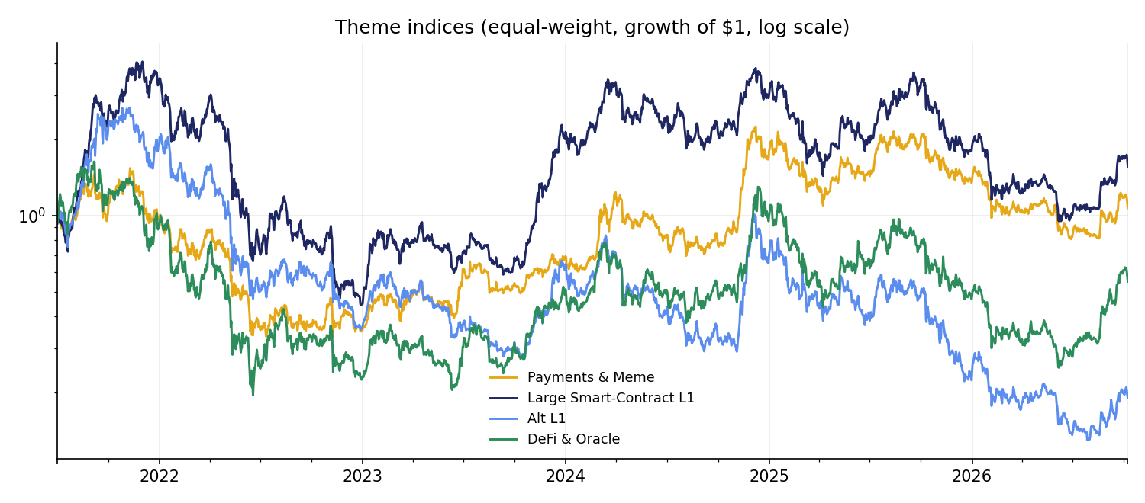
MOMENTUM: THEMES AND TECHNICAL PLAYS
Themes worked, then decayed; front-running fails on cost
Theme look-back
Gross IS
Gross OOS
Net 20 bps
7 days
1.31
0.46
-0.89
14 days
2.02
0.66
0.15
21 days
1.99
0.30
0.21
30 days
1.76
0.33
0.23
FRONT-RUNNING THE US SESSION
1.63 bps/day
Theme momentum was the strongest research-period signal (14-day gross Sharpe 2.02). In 2024-2026 theme moves came in sharp bursts that reversed, and the signal decayed to 0.66.
Coins that led yesterday's US session lead again (Sharpe 0.53, t = 1.17), but a full daily round trip costs more than the edge even at 7 bps.
7

Slide 8
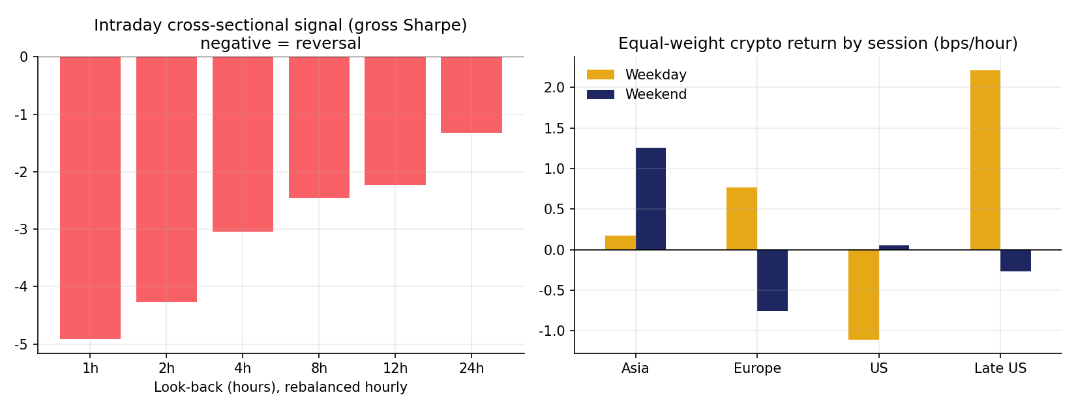
REVERSAL: HORIZON, UNINFORMED TRADING, CORRELATION
Reversal is real; only the slow version pays
Reversal type
Gross Sharpe
Net cost
Turnover
1-hour cross-sectional
4.91
-43 @7
1.34/h
Market-residual 7d
-1.01
-1.66 @7
0.51/d
Theme-residual 60d
0.78
0.49 @7
0.20/d
Cointegrated pairs
0.24
-0.11 @20
0.033/d
60d, skip 14d (selected)
1.02
0.94 @7
0.06/d
- Short horizon: hour-to-hour moves are liquidity noise and reverse strongly, but turnover makes it a market-maker's edge, not ours.
- Correlation: residuals vs the whole market trend; residuals vs the coin's own theme revert over 1-2 months.
- Long horizon: 60-day losers beat 60-day winners - overreaction compressed into weeks.
8

Slide 9
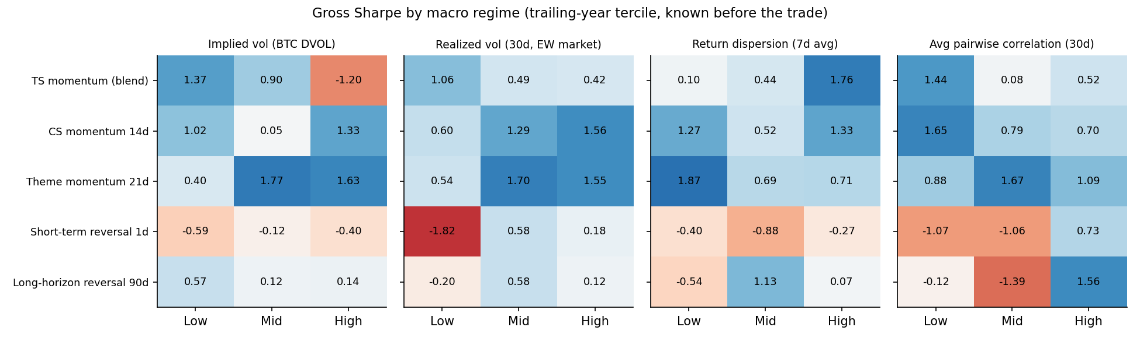
MACRO: VOLATILITY AND DISLOCATION
Stress helps reversal; high implied vol breaks momentum
1-DAY REVERSAL, CALM VS VOLATILE
TS MOMENTUM, IMPLIED VOL
Action: switch time-series momentum off when DVOL is in its top tercile (selected on the research period).
-1.82 / 0.58
1.37 / -1.20
Sharpe: low vs mid realized vol
Sharpe: low vs high DVOL
9

Slide 10
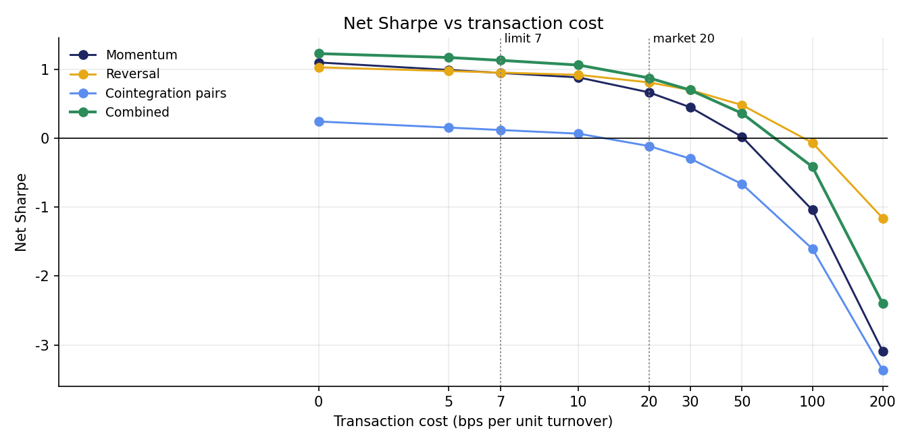
EXECUTION
Turnover, not signal discovery, is the binding constraint
Momentum book
Turnover
Gross
7 bps
20 bps
Daily rebalance
0.237
1.26
1.08
0.75
Hold 7d (overlapping)
0.137
0.69
0.58
0.39
No-trade band 2%
0.197
1.26
1.11
0.83
No-trade band 5%
0.137
0.95
0.84
0.63
- Bands beat holding periods: a 2% no-trade band cuts momentum turnover without diluting the signal (20 bps Sharpe 0.75 -> 0.83).
- Limit orders: the slow reversal book is worked passively at 7 bps; the combined book stays positive to ~50 bps (Sharpe 0.36).
10

Slide 11
SELECTION AND WEIGHTING
Diversify the momentum bet, then combine with reversal
MOMENTUM ENSEMBLE (20 BPS)
Weighting
IS
OOS
Full
- TS momentum blend H=1 + DVOL filter
- Theme momentum L=14 H=7
- CS momentum L=14 H=7
Equal weight
1.44
0.70
1.02
Inverse volatility
1.54
0.80
1.10
REVERSAL (7 BPS)
Risk parity (ERC)
1.54
0.80
1.10
Long-horizon reversal L=60 skip=14 H=14
Mean-variance (shrunk)
1.71
0.55
1.02
If the momentum sleeve were...
Hold-out Sharpe
Momentum and reversal correlate at only 0.08, so every weighting scheme beats either sleeve alone. Mean-variance (shrunk) won on the research period; simpler risk-based weights did slightly better in the hold-out.
Picking the single best momentum strategy would have failed out of sample - the main lesson on selection risk.
Ensemble (final)
0.55
Single IS-best pick
0.09
TS momentum only
0.68
11

Slide 12
PERFORMANCE EVALUATION
Returns, volatility, Sharpe, drawdown, alpha and beta
Full backtest
Return
Vol
Sharpe
Max DD
Alpha
Beta
OOS Sharpe
Combined portfolio
20.2%
19.7%
1.02
-28.1%
20.6%
-0.02
0.55
Combined (all at 20 bps)
17.3%
19.8%
0.88
-28.6%
17.8%
-0.02
0.38
Momentum ensemble
22.3%
33.3%
0.67
-31.1%
25.2%
-0.13
0.22
Reversal (7 bps)
18.7%
19.6%
0.95
-33.7%
18.7%
0.00
1.00
Cointegration pairs
-0.7%
6.6%
-0.11
-12.9%
-0.9%
0.01
-0.37
Equal-weight crypto
9.3%
70.1%
0.13
-77.4%
-17.4%
1.17
0.31
Buy & hold BTC
22.9%
50.8%
0.45
-67.0%
0.0%
1.00
0.74
2021-12-28 to 2026-10-08. Alpha / beta vs Bitcoin (daily regression, Newey-West). Combined alpha t-stat 2.19. OOS = hold-out 2024-01-01 onward.
12

Slide 13
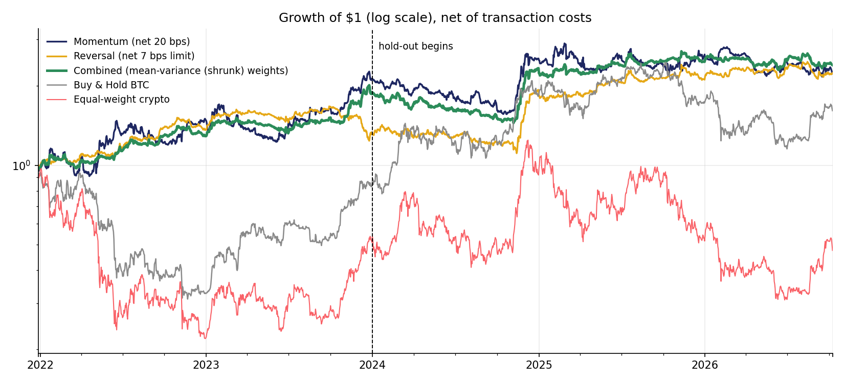
RESULTS
Growth of $1: steady, market-neutral compounding
RESEARCH PERIOD SHARPE
1.71
2021-2023, max DD -12.6%
HOLD-OUT SHARPE
0.55
2024-2026, alpha 11.6%/yr
Combined vs BTC
Sharpe
BTC Sharpe
Alpha / yr
Max DD
BTC Max DD
BETA TO BTC
Research period
1.71
0.11
33.0%
-12.6%
-67.0%
-0.02
Hold-out
0.55
0.74
11.6%
-23.5%
-53.1%
Full
1.02
0.45
20.6%
-28.1%
-67.0%
BTC drawdown -67.0%
13

Slide 14
CONCLUSION
Signals exist; execution and diversification decide
- Momentum at days-to-weeks, reversal at hours and months. The brief's hypotheses on activity, seasonality, themes and macro are all visible in the data.
- Costs kill fast signals. Bands, slow signals and limit orders turn gross edges into net ones.
- Combine uncorrelated sleeves. Momentum + reversal: Sharpe 1.02, beta -0.02.
- Expect decay. Hold-out Sharpe 0.55; next step is live paper trading.
1.02
20.6%
-0.02
-28.1%
NET SHARPE
ALPHA / YR
BETA
MAX DD
14

